Slide 1
Business Intelligence and Business Analytics (H9BIBA)
Introduction to Tableau

Slide 2

https://www.tableau.com/academic/students

Slide 3
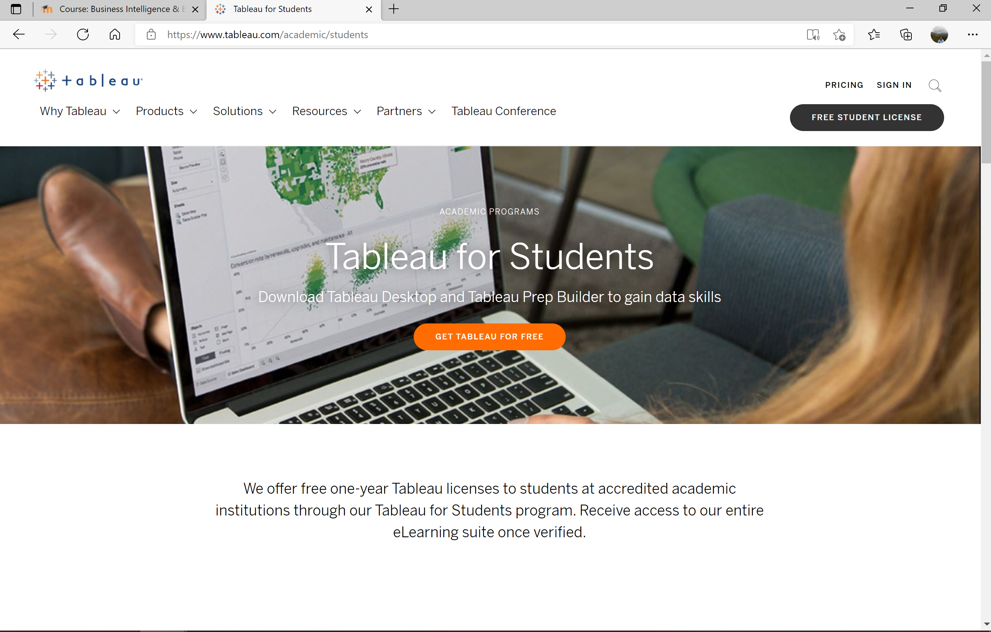
Click “free student license” Highlighted Below

Slide 4
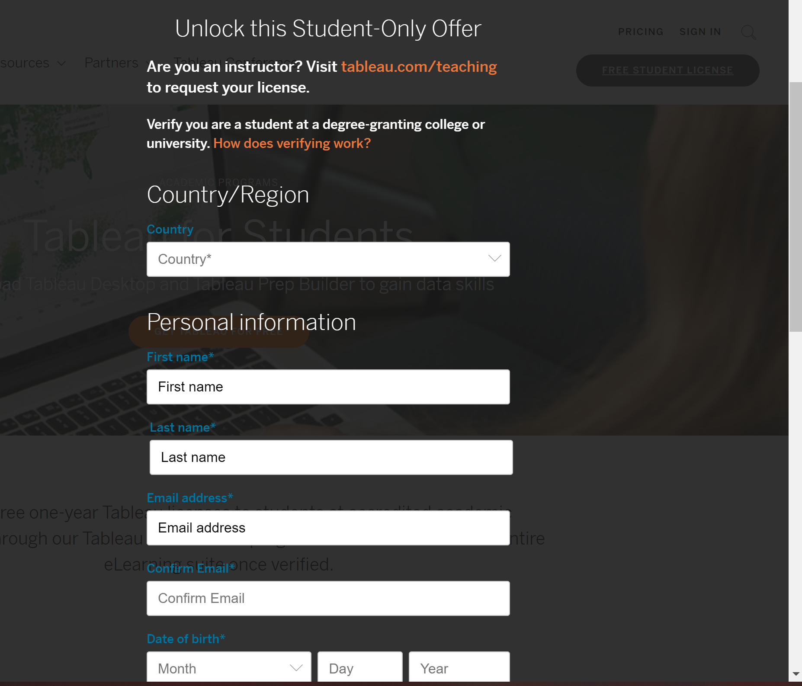
Complete the registration must use college email address
Complete the registration using your NCI email address

Slide 5
Now do the tutorials and explore the eLearning content at the links given in the Lab section for this week on Moodle

